Slide 2
The New Deal
FDR’s Answer to the Great Depression
By: Christopher W. Miller

Slide 3
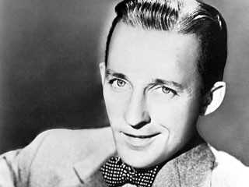
Brother, Can You Spare a Dime? As Sung By: Bing Crosby
They used to tell me I was building a dream
And so I followed the mob
When there was earth to plow or guns to bear I was always there, right on the job
They used to tell me I was building a dream
With peace and glory ahead
Why should I be standing in line
Just waiting for bread?
Once I built a railroad, I made it run
Made it race against time
Once I built a railroad, now it's done
Brother, can you spare a dime?
Once I built a tower up to the sun
Brick and rivet and lime
Once I built a tower, now it's done
Brother, can you spare a dime?
Once in khaki suits, gee, we looked swell
Full of that Yankee Doodly Dum
Half a million boots went slogging through Hell
And I was the kid with the drum
Say, don't you remember?
They called me 'Al'
It was 'Al' all the time
Why don't you remember? I'm your pal
Say buddy, can you spare a dime?
Once in khaki suits, ah, gee, we looked swell
Full of that Yankee Doodly Dum
Half a million boots went slogging through Hell
And I was the kid with the drum
Oh, say, don't you remember?
They called me 'Al'
It was 'Al' all the time
Say, don't you remember? I'm your pal
Buddy, can you spare a dime?

Slide 4
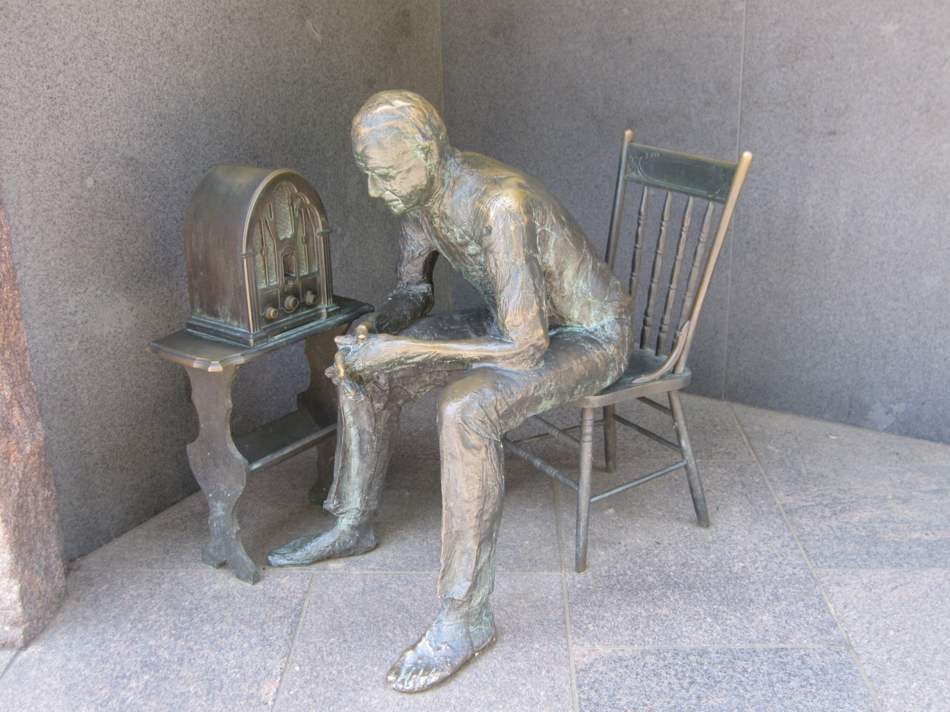
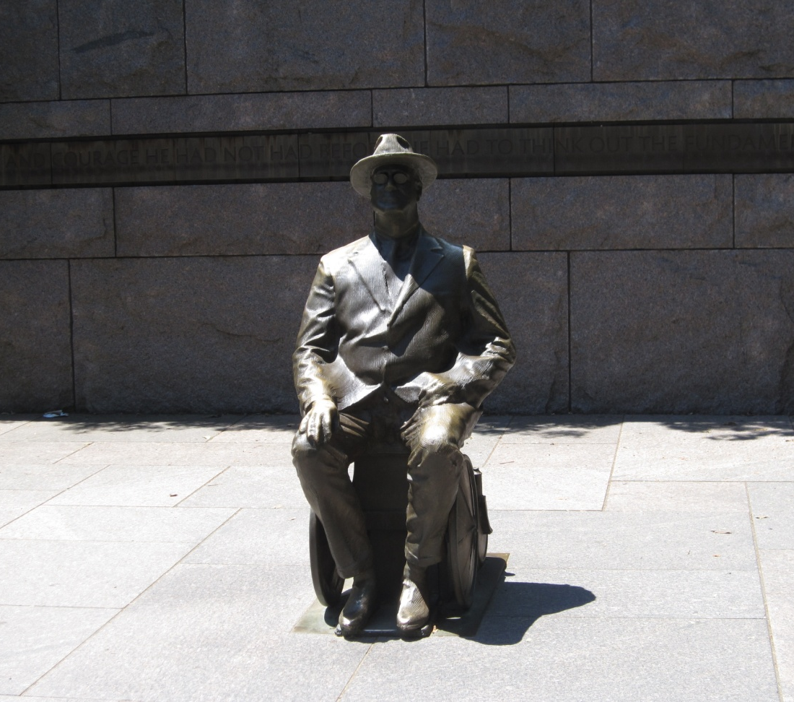
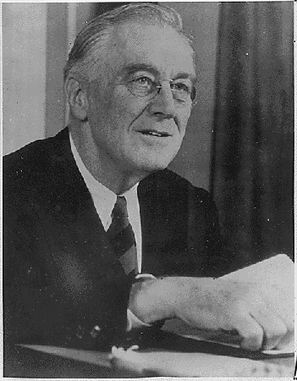
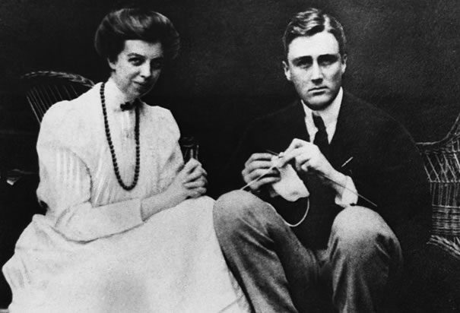
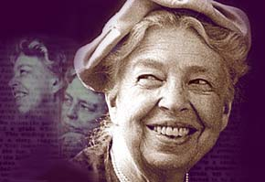
Who was FDR?
Born in 1882 in Hyde Park, NY, Franklin Delano Roosevelt was an expert politician who was elected governor of New York twice before he became president.
He married his distant cousin Eleanor Roosevelt in 1905. She worked often with the poor and exposed FDR to the problems of the common man.
He developed Polio in 1921. He was paralyzed from the waist down for the rest of his life.
He won the presidential election as a democrat in 1932 by 7 million votes. He would be elected a record number 4 times.
He was famous for radio broadcasts or “Fireside Chats”. Through them, he made a connection to everyday people.

Slide 5
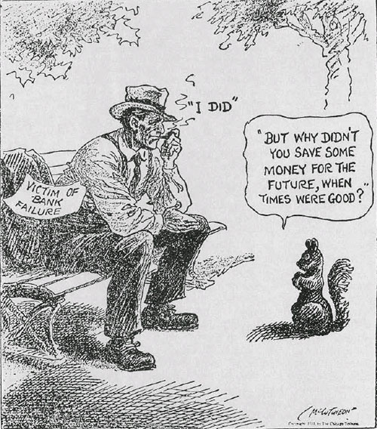
The First 100 Days – Fixing the Banks
The New Deal was FDR’s plan to end the Great Depression. He first tried to fix the banks.
FDR created a bank holiday on 2/3/1933 in order to give banks a break and give Congress a chance to fix them.
Congress would first pass the Emergency Banking Relief Act which allowed the U.S. Treasury to inspect banks.
Congress would then pass Glass-Steagall Act which established the Federal Deposit Insurance Corporation, (FDIC) which provided insurance for individual bank accounts of up to $5000.
Congress would also pass the Federal Securities Act . It forced corporations to be more truthful. This led to the Securities and Exchange Commission (SEC) which monitors company activities and regulates the stock market.

Slide 6
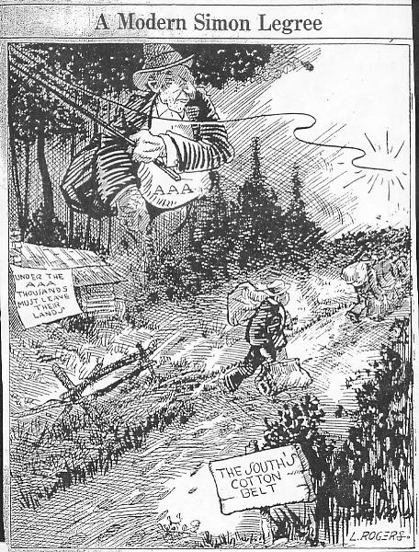
The First 100 Days – Alphabet Soup
FDR and Congress also created organizations and programs to help other areas of society.
AAA: the Agricultural Adjustment Administration – it tried raise crop prices by lowering production. It paid farmers subsidies to not plant crops and decrease production
TVA: the Tennessee Valley Authority – helped the Tennessee River Valley by building dams in the region. This provided jobs and electricity to thousands.
CCC: the Civilian Conservation Corps. – put 100,000s of men to work on environmental projects
PWA: the Public Works Administration – put 100,000s of men to work building roads, schools, and other facilities

Slide 7
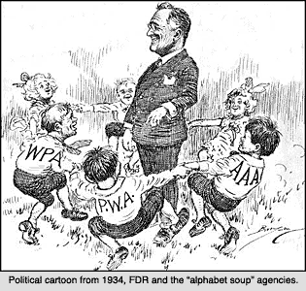
Alphabet Soup Continued
CWA: Civil Works Administration - which provided 4 million immediate jobs in the winter of 1933-1934. It built schools, roads, and paid teachers.
FERA: The Federal Emergency Relief Administration was made to distribute $500 million to state and local relief agencies
NRA: National Recovery Administration (NRA) which was to help revive industry by stopping wage cuts, falling prices and layoffs.
During the first 100 days, FDR proposed 15 bills, all 15 were passed by Congress with few changes. The programs created became known as “alphabet soup”.

Slide 8
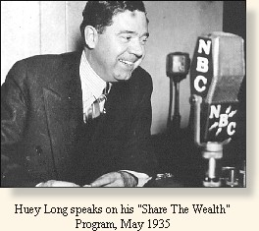
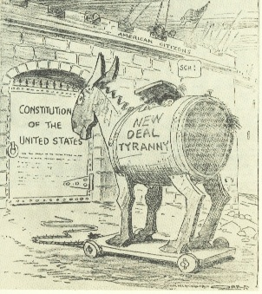
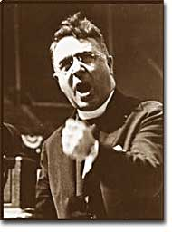
Opposition to the New Deal
Many people did not approve of the New Deal.
Tenant Farmers: disapproved b/c money from the AAA that went to farms went to land owners, not to those who worked the land
Father Charles Coughlin: Catholic priest who used his radio show in Detroit to speak out against New Deal programs. He was taken off the air b/c of anti-Semitism.
Senator Huey Long: Louisiana senator who used his position to work against the New Deal. He believed in sharing the wealth between rich and poor. He was assassinated.
Both of these men were called demagogues, as they manipulated people with half-truths and scare tactics.
The Supreme Court overturned the passage of some New Deal programs, calling them unconstitutional

Slide 9
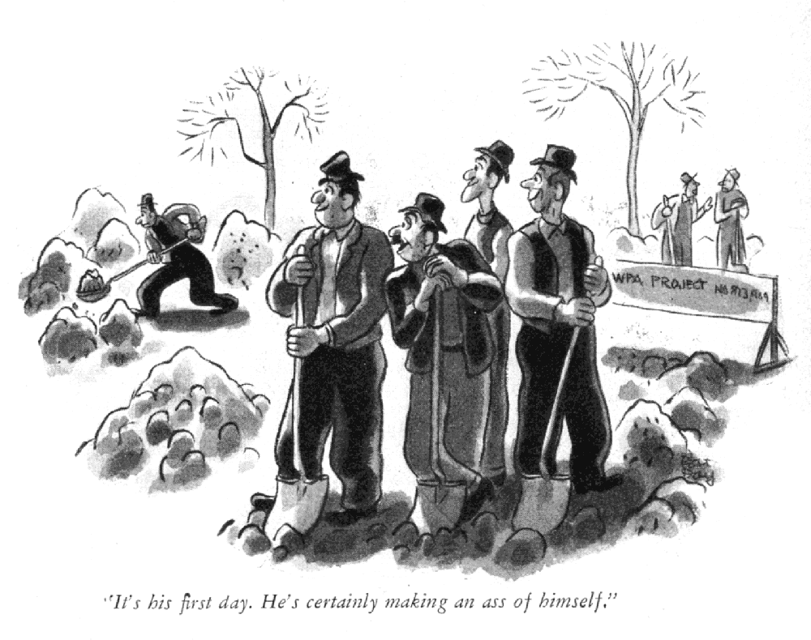
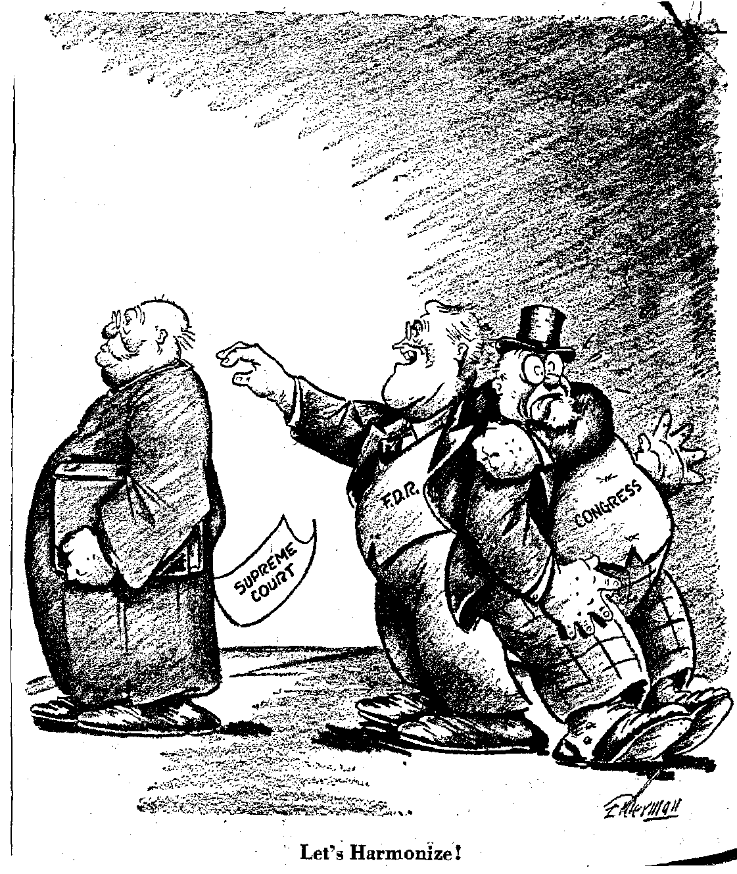
The 2nd New Deal
FDR countered this criticism with the 2nd New Deal.
FDR first tried to reorganize the Supreme Court. He wanted to increase the size of the court and put his friends in the new seats. This was called “court packing” and Americans did not approve of it. This brought about the greatest opposition to the New Deal. FDR had to compromise here, and settled for appointing one new justice to the court.
The Works Progress Administration (WPA) was created in April of 1935. It was an $11 billion relief program headed by Harry Hopkins which distributed its money according to the applications it received and approved of. It was very successful and gave jobs to 8 million people in a variety of fields.

Slide 10
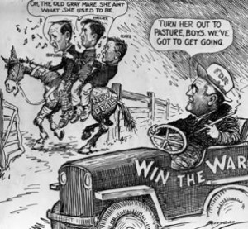
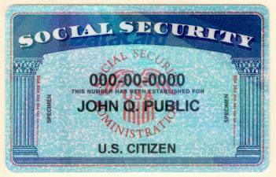
The 2nd New Deal Continued
The Social Security Act was passed in Aug. 1935. Through this, the federal government took responsibility for the basic needs of its citizens. It provided pensions for the elderly and aid to those injured in industrial accidents. However, it failed to help minorities.
Other recovery acts included the Wagner Act of July 1935 which aided industry, the Soil Conservation Act of 1936 which was to help farmers, and the Rural Electrification Act of 1935 which lent money to farmers to build power plants. This last one brought electricity to 90% of all farms.
But neither the 1st New Deal or the 2nd New Deal would get enough Americans working again. It was World War II which would eventually bring the U.S. out of the Great Depression.

Slide 11
The Great Depression would end……..
But only after World War II started and the U.S. began producing goods for the Allied forces

